Slide 1

XIOVE
A Professional Inforgraphic Statistic Presentation Template
2025

Slide 2
About
XIOVE
Welcome Message
We always try to give the best product to you that will accommodate all your business needs, from the very little thing to the biggest one. The satisfaction of our customers is something that should not be ignored so we always work by adhering to professionalism and integrity. All these graphics, charts and statistics we provided here are proof of our hard work

Slide 3
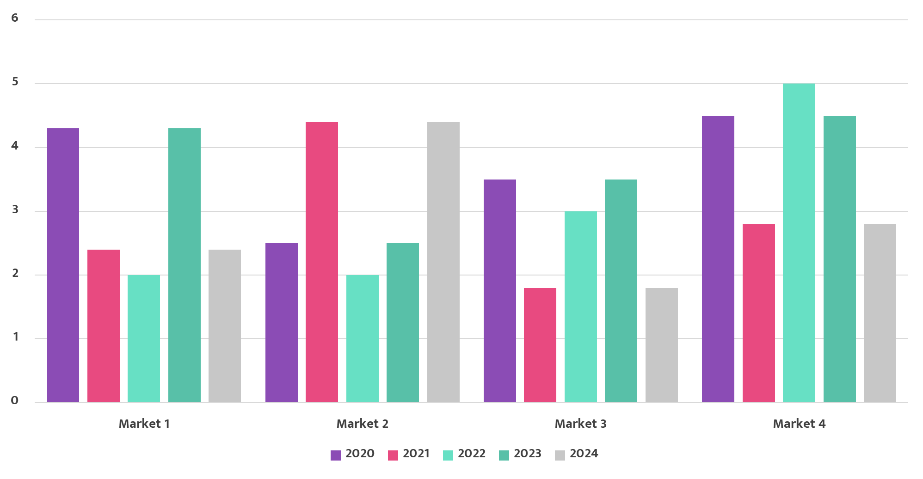
Annual
Sales
Report
Our Sales In The Past Few Years
We always try to give the best product to you that will accommodate all your business needs, from the very little thing to the biggest one. The satisfaction of our customers is something that should not be ignored so we always work by adhering to professionalism and integrity. All these graphics, charts and statistics we provided here are proof of our hard work
2025

Slide 4

Marketing
Area
The Marketing Area Is Growing Fast, With Higher Demand Every Year From Inside And Outside The Country
XIOVE Company

Slide 5
S.W.O.T
Analysis
XIOVE Company
Our Strong Points
Our Week Points
S
What the company should do to support the salesWhat the company should do to support the salesWhat the company should do to support the sales
W
The Marketing Area Is Growing Fast, With Higher Demand Every Year From Inside And Outside The Country
Our Opportunities
Our Treats
O
The Marketing Area Is Growing Fast, With Higher Demand Every Year From Inside And Outside The Country
T
The Marketing Area Is Growing Fast, With Higher Demand Every Year From Inside And Outside The Country

Slide 6
Price
Adjustment
Plan
In The Future, We Will Make Adjustments To The Prices Of The Products We Offer
Regular Product
Premium Product
Special Edition Product
Start From
$25
Start From
$55
Start From
$75
XIOVE Company

Slide 7
Sales Support
Hands-on Practice
System & Tools
Objection Handling
Pipeline Management
Pitch Practice
Consultative Sales
Sales Coaches
Sales
Development Programs
What The Company Should Do To Support The Sales
What the company should do to support the salesWhat the company should do to support the salesWhat the company should do to support the sales

Slide 8
Business
2025
Timeline
2018
2019
2020
Establishment
Fundraising
First products on the market
2021
2022
2023
Gain profit $3M
Expanded business by building an offline store
Set up the first official store overseas
XIOVE Company

Slide 9





Project of
New Product
Month 1
Month 2
Month 3
Month 4
Month 5
Research
Design
Production
Sell
Overseas store
XIOVE Company

Slide 10
Contact
Us
123 Anywhere St., Any City, ST 12345
+123-456-7890
hello@reallygreatsite.com
www.reallygreatsite.com
XIOVE Company

